Slide 1
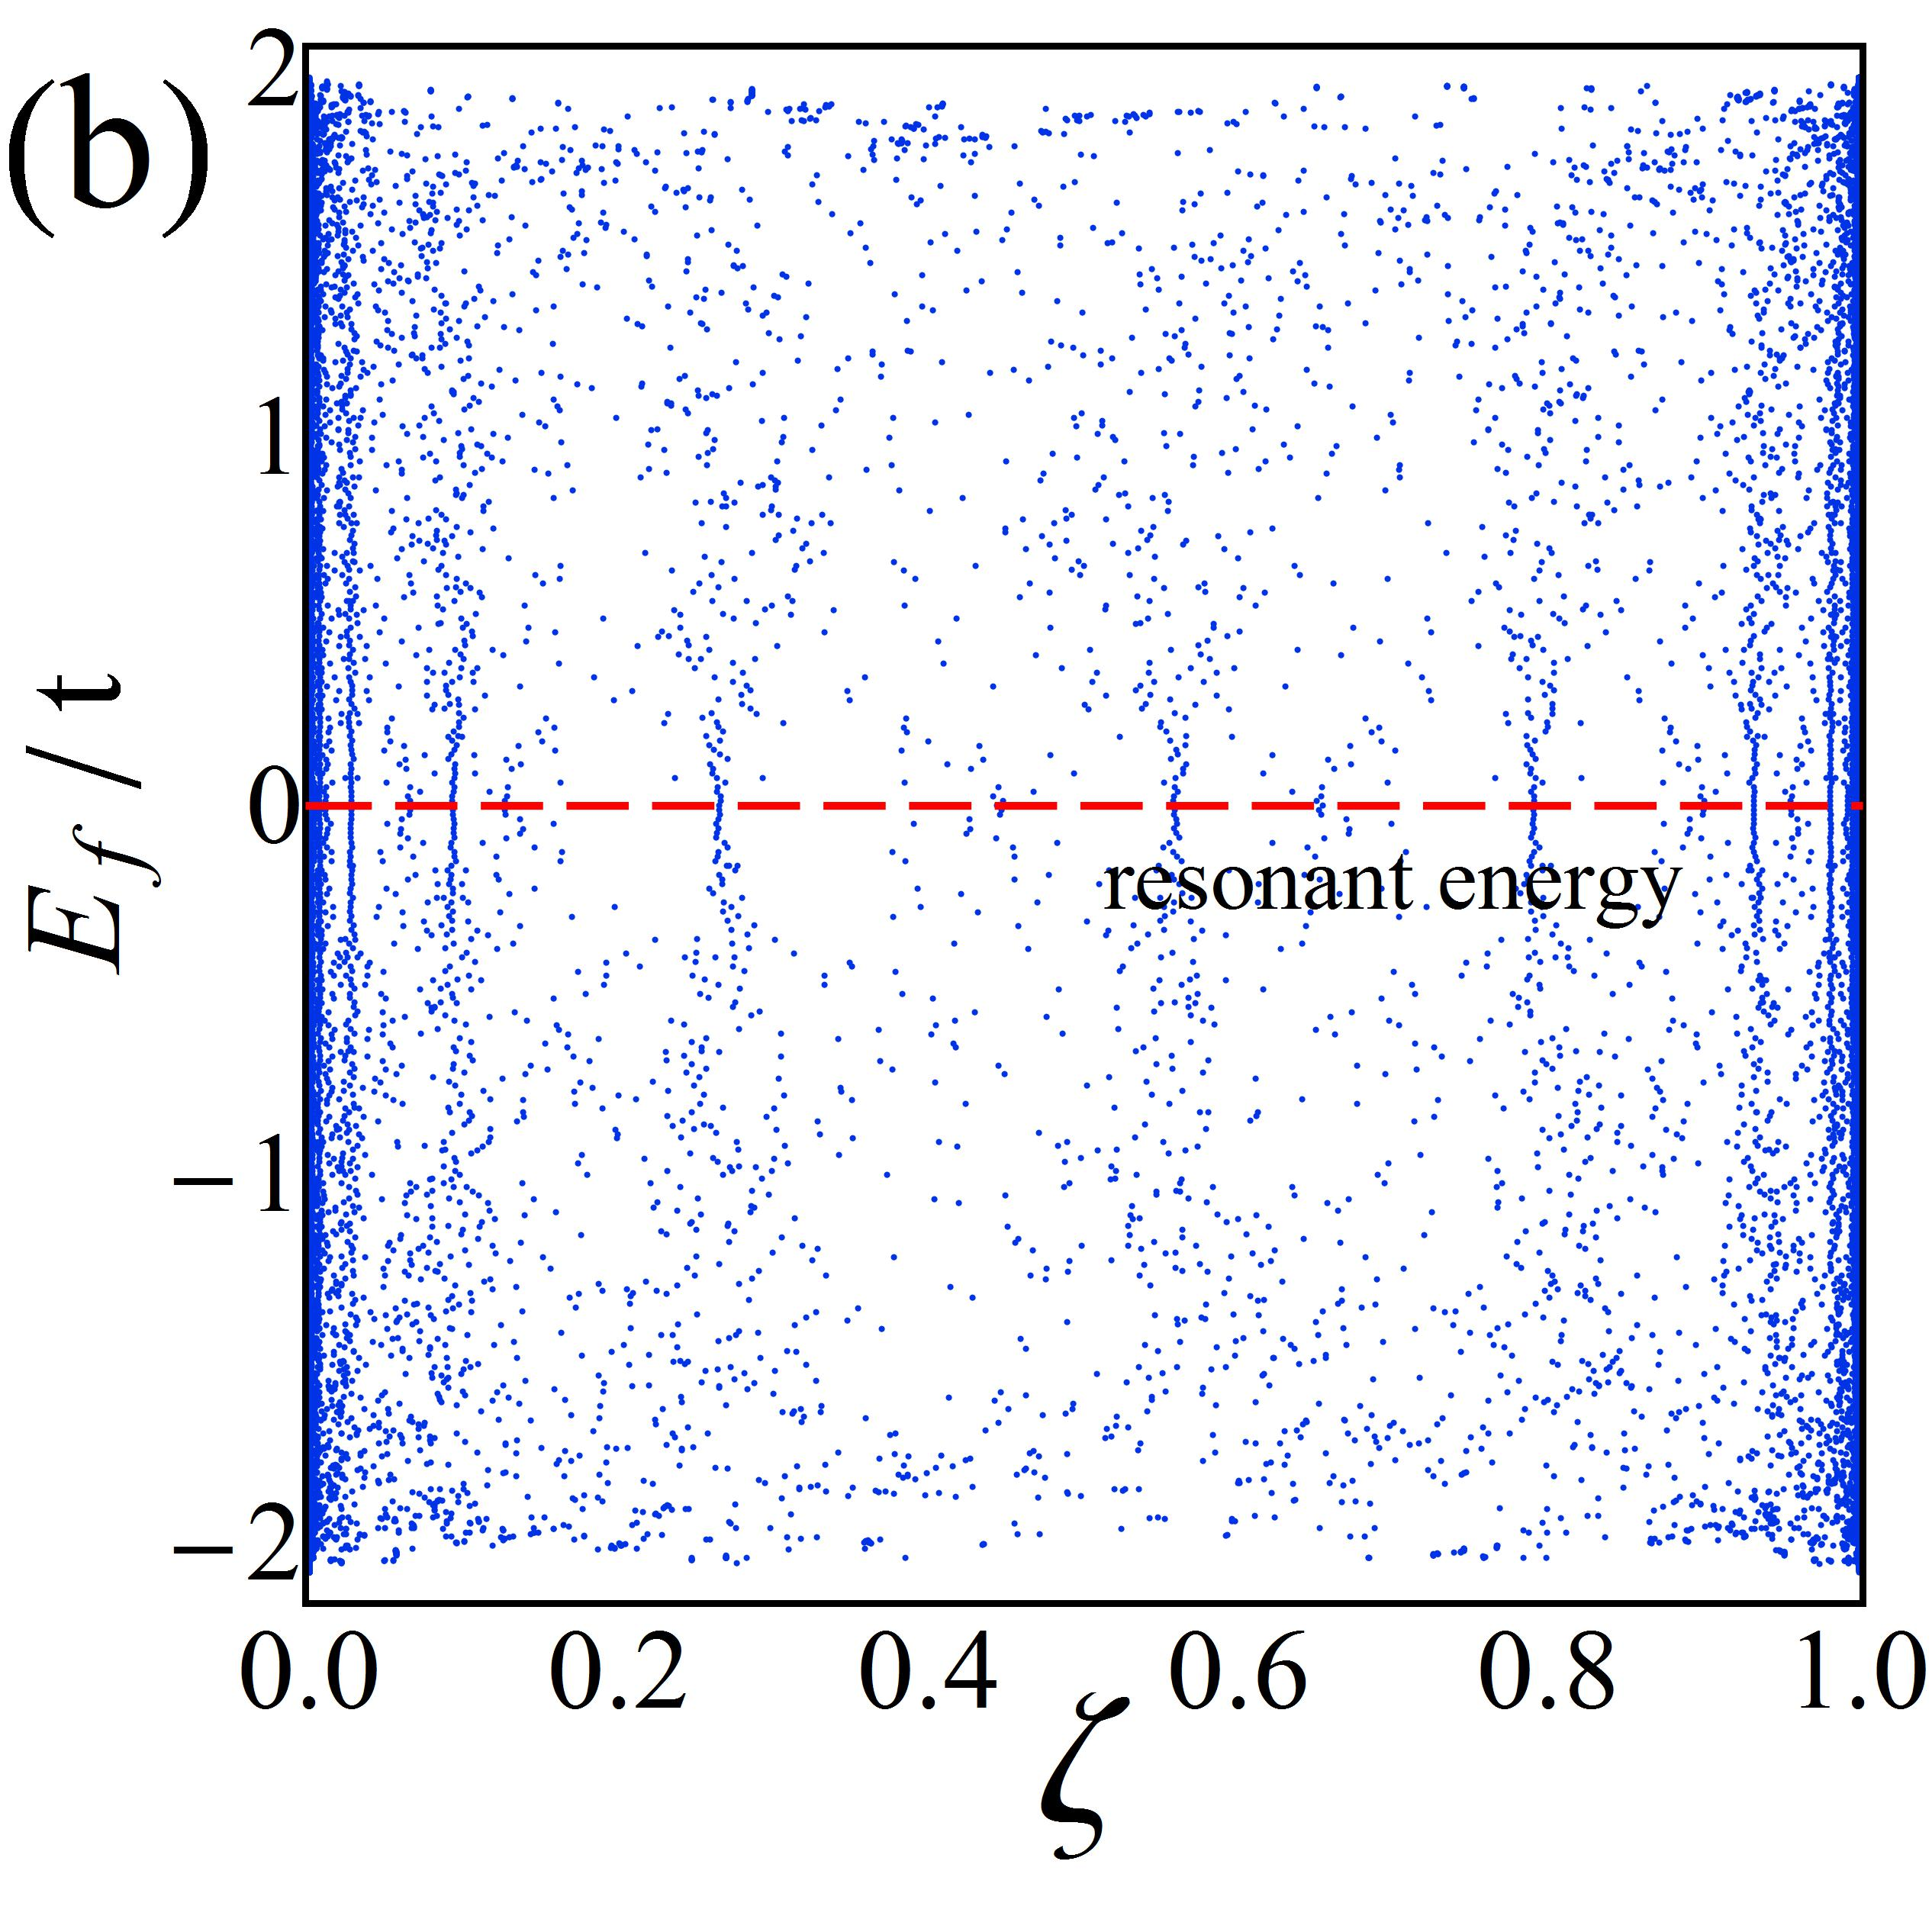
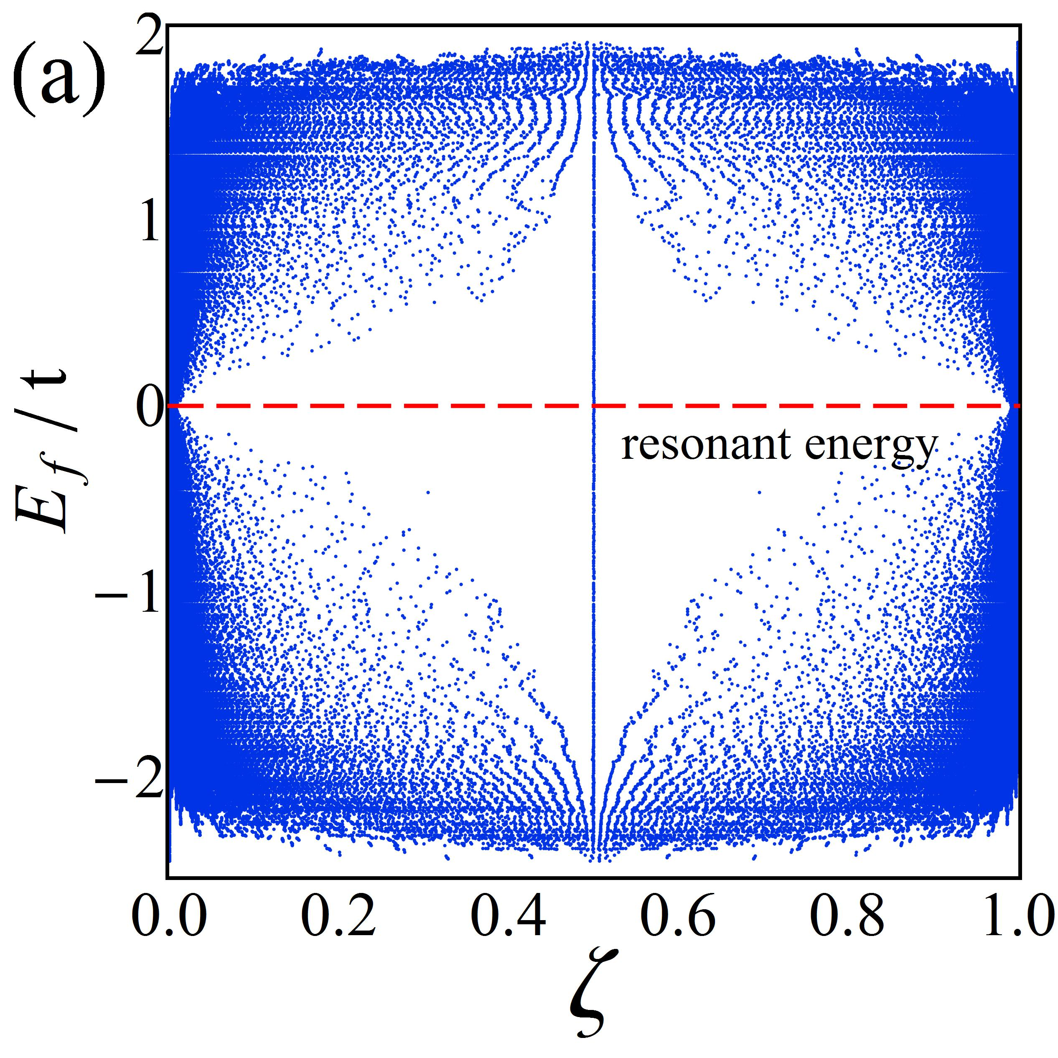
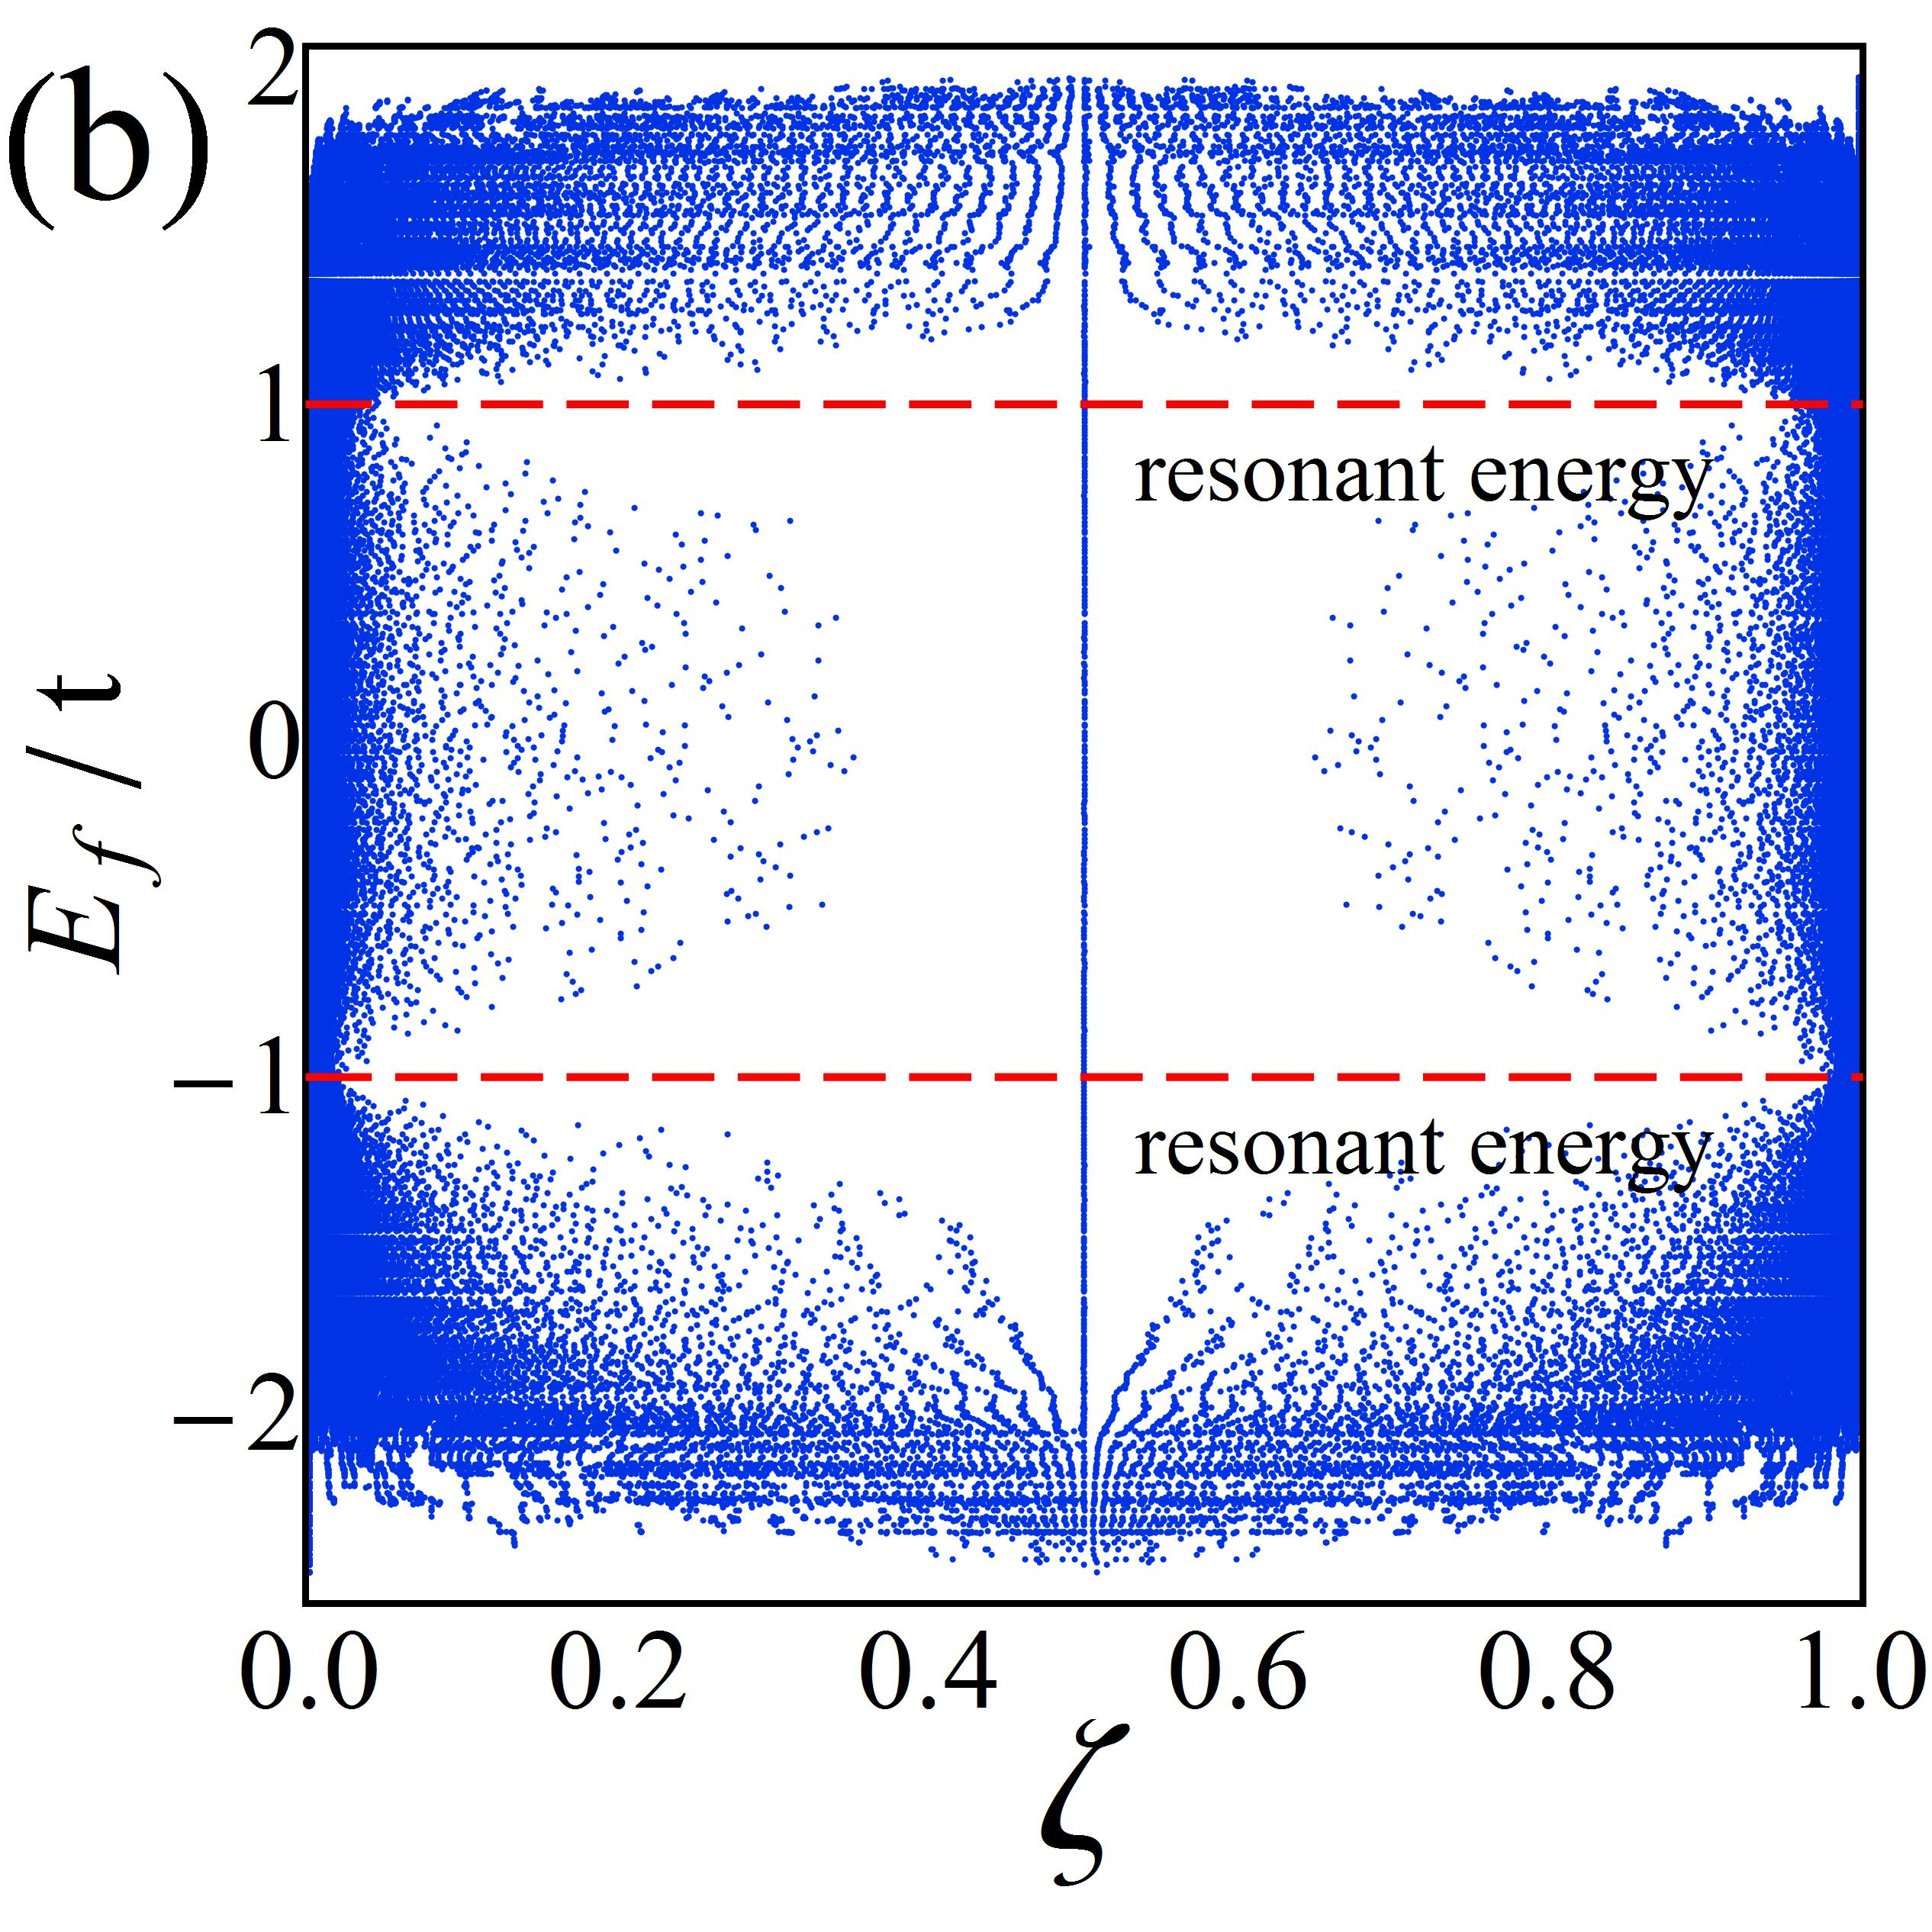
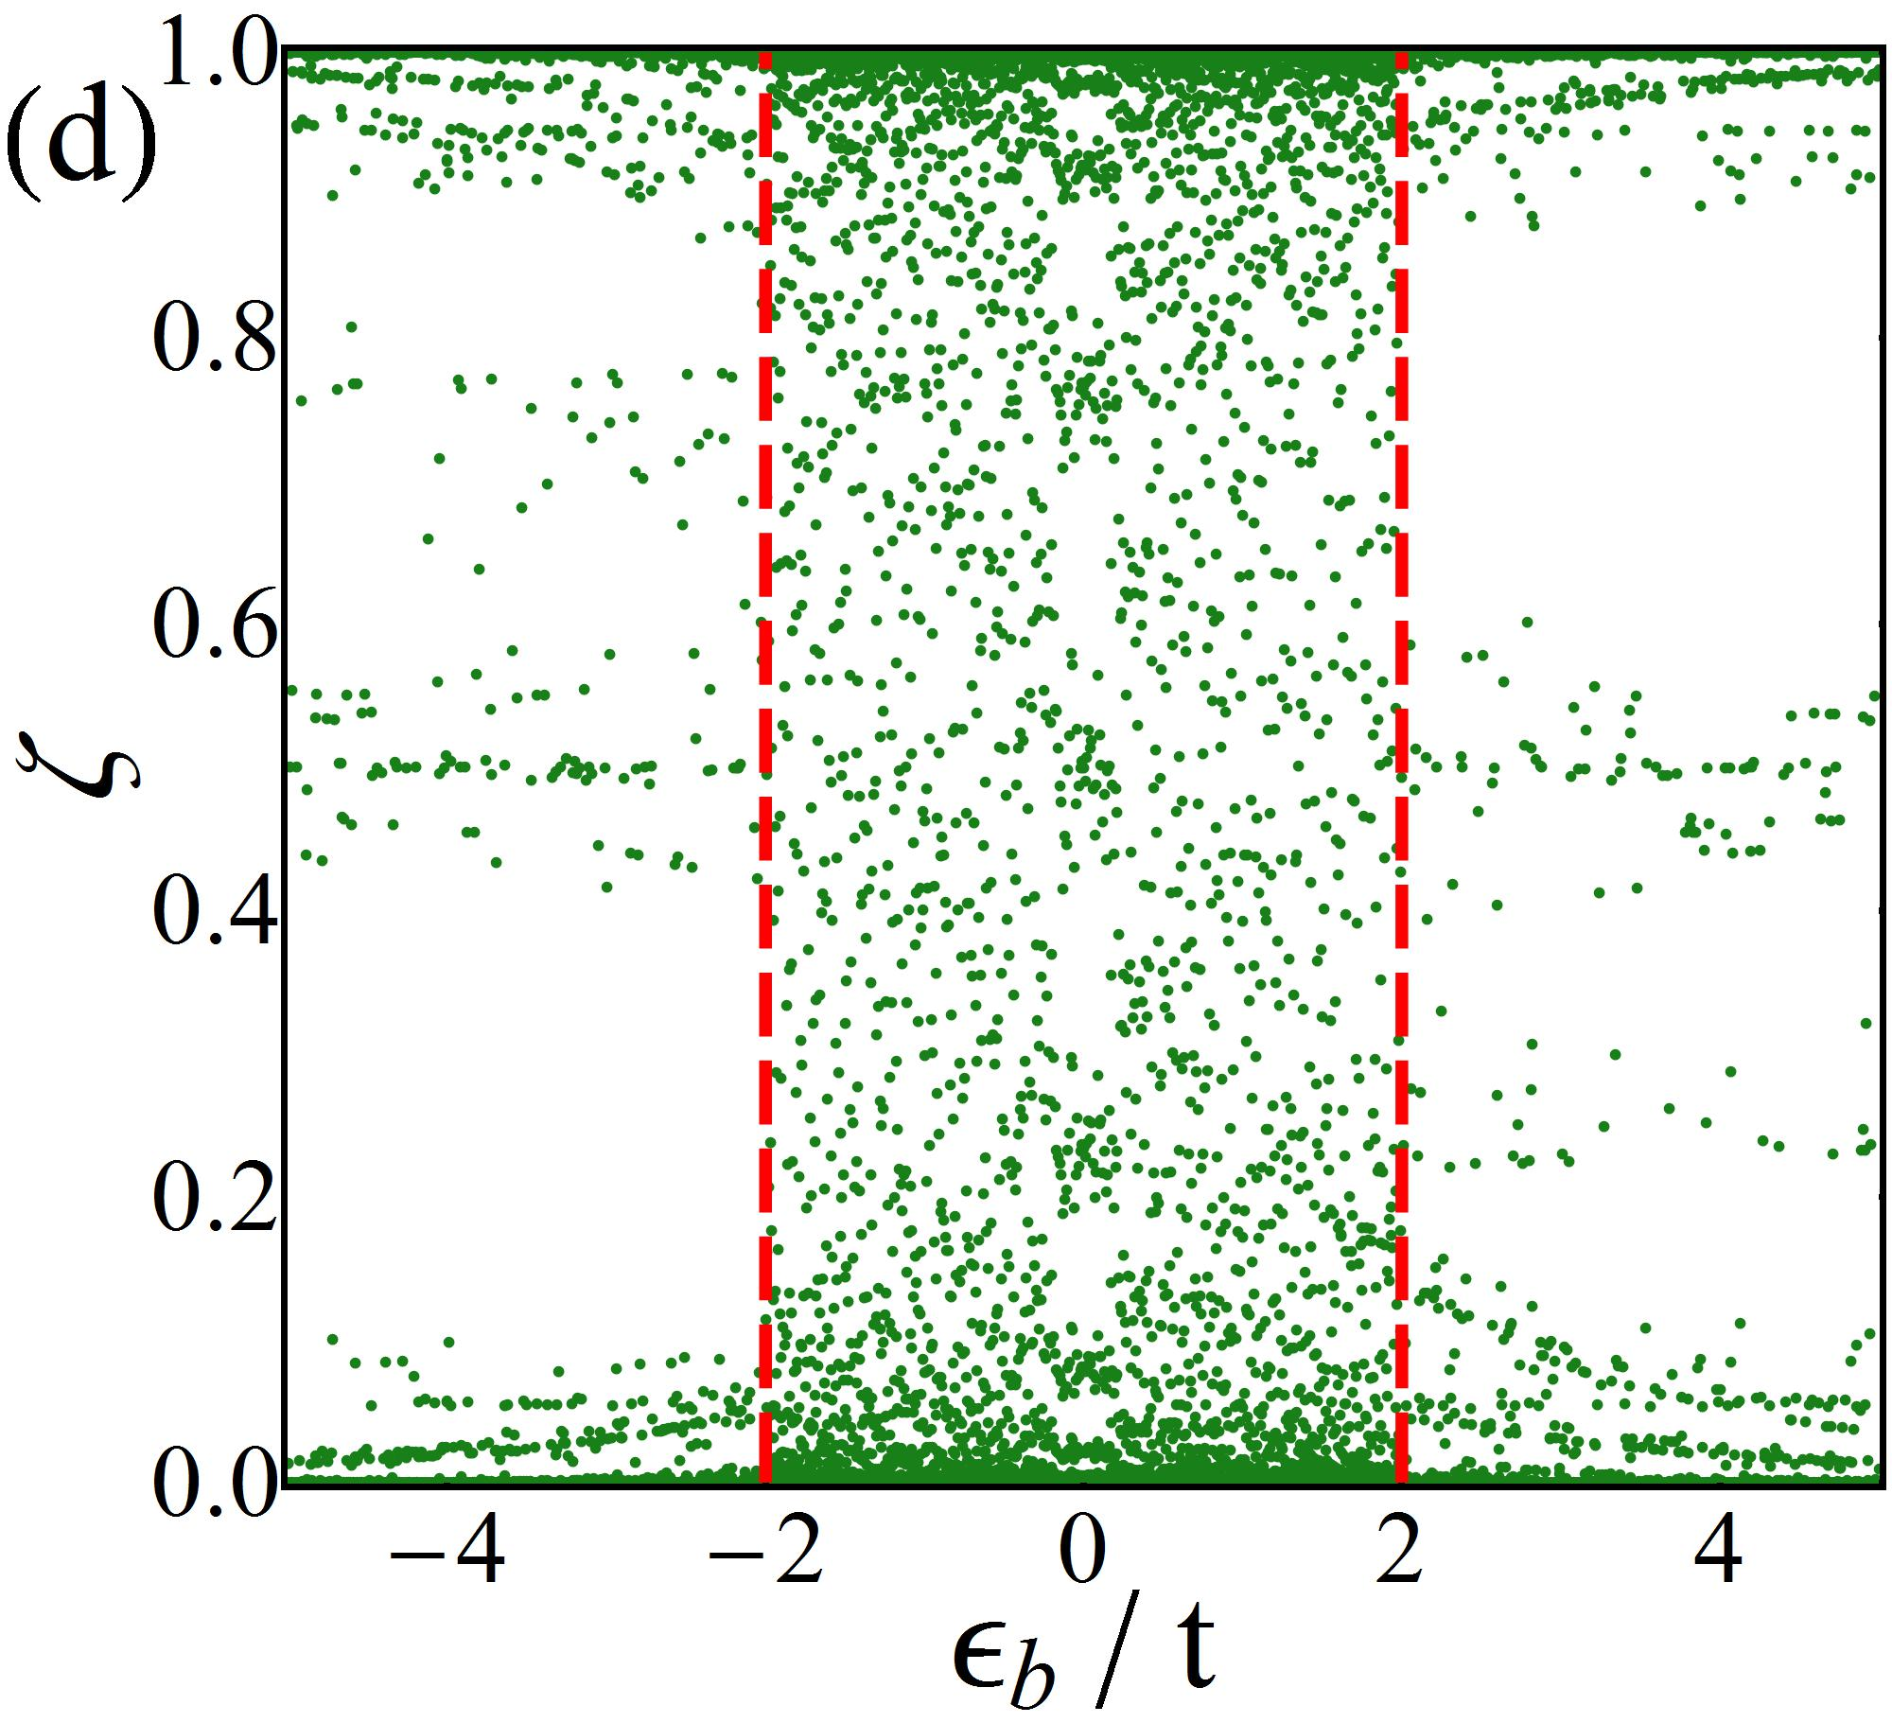
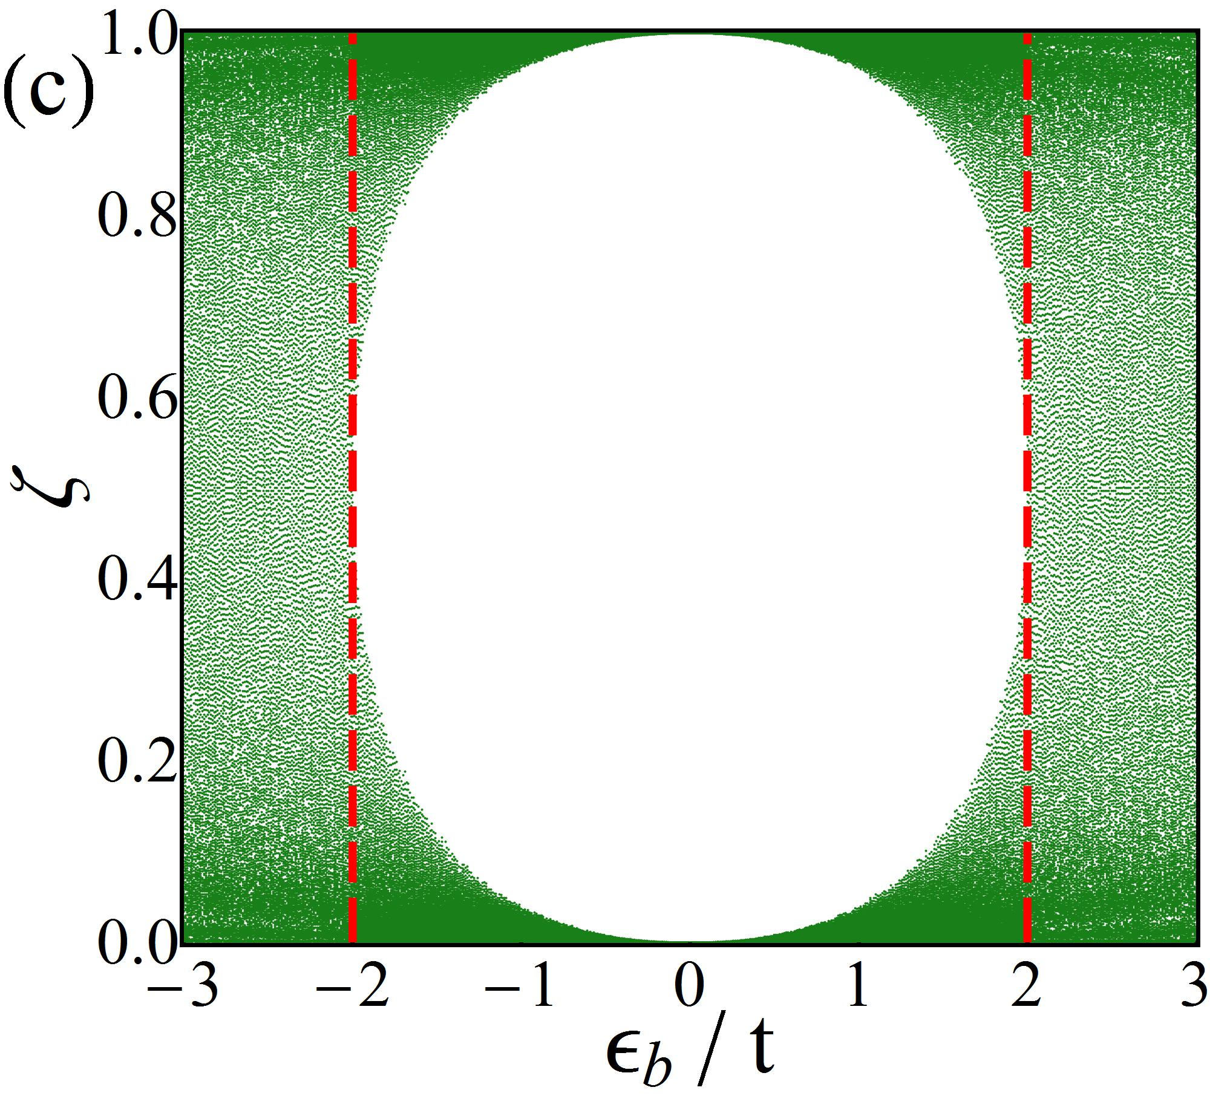
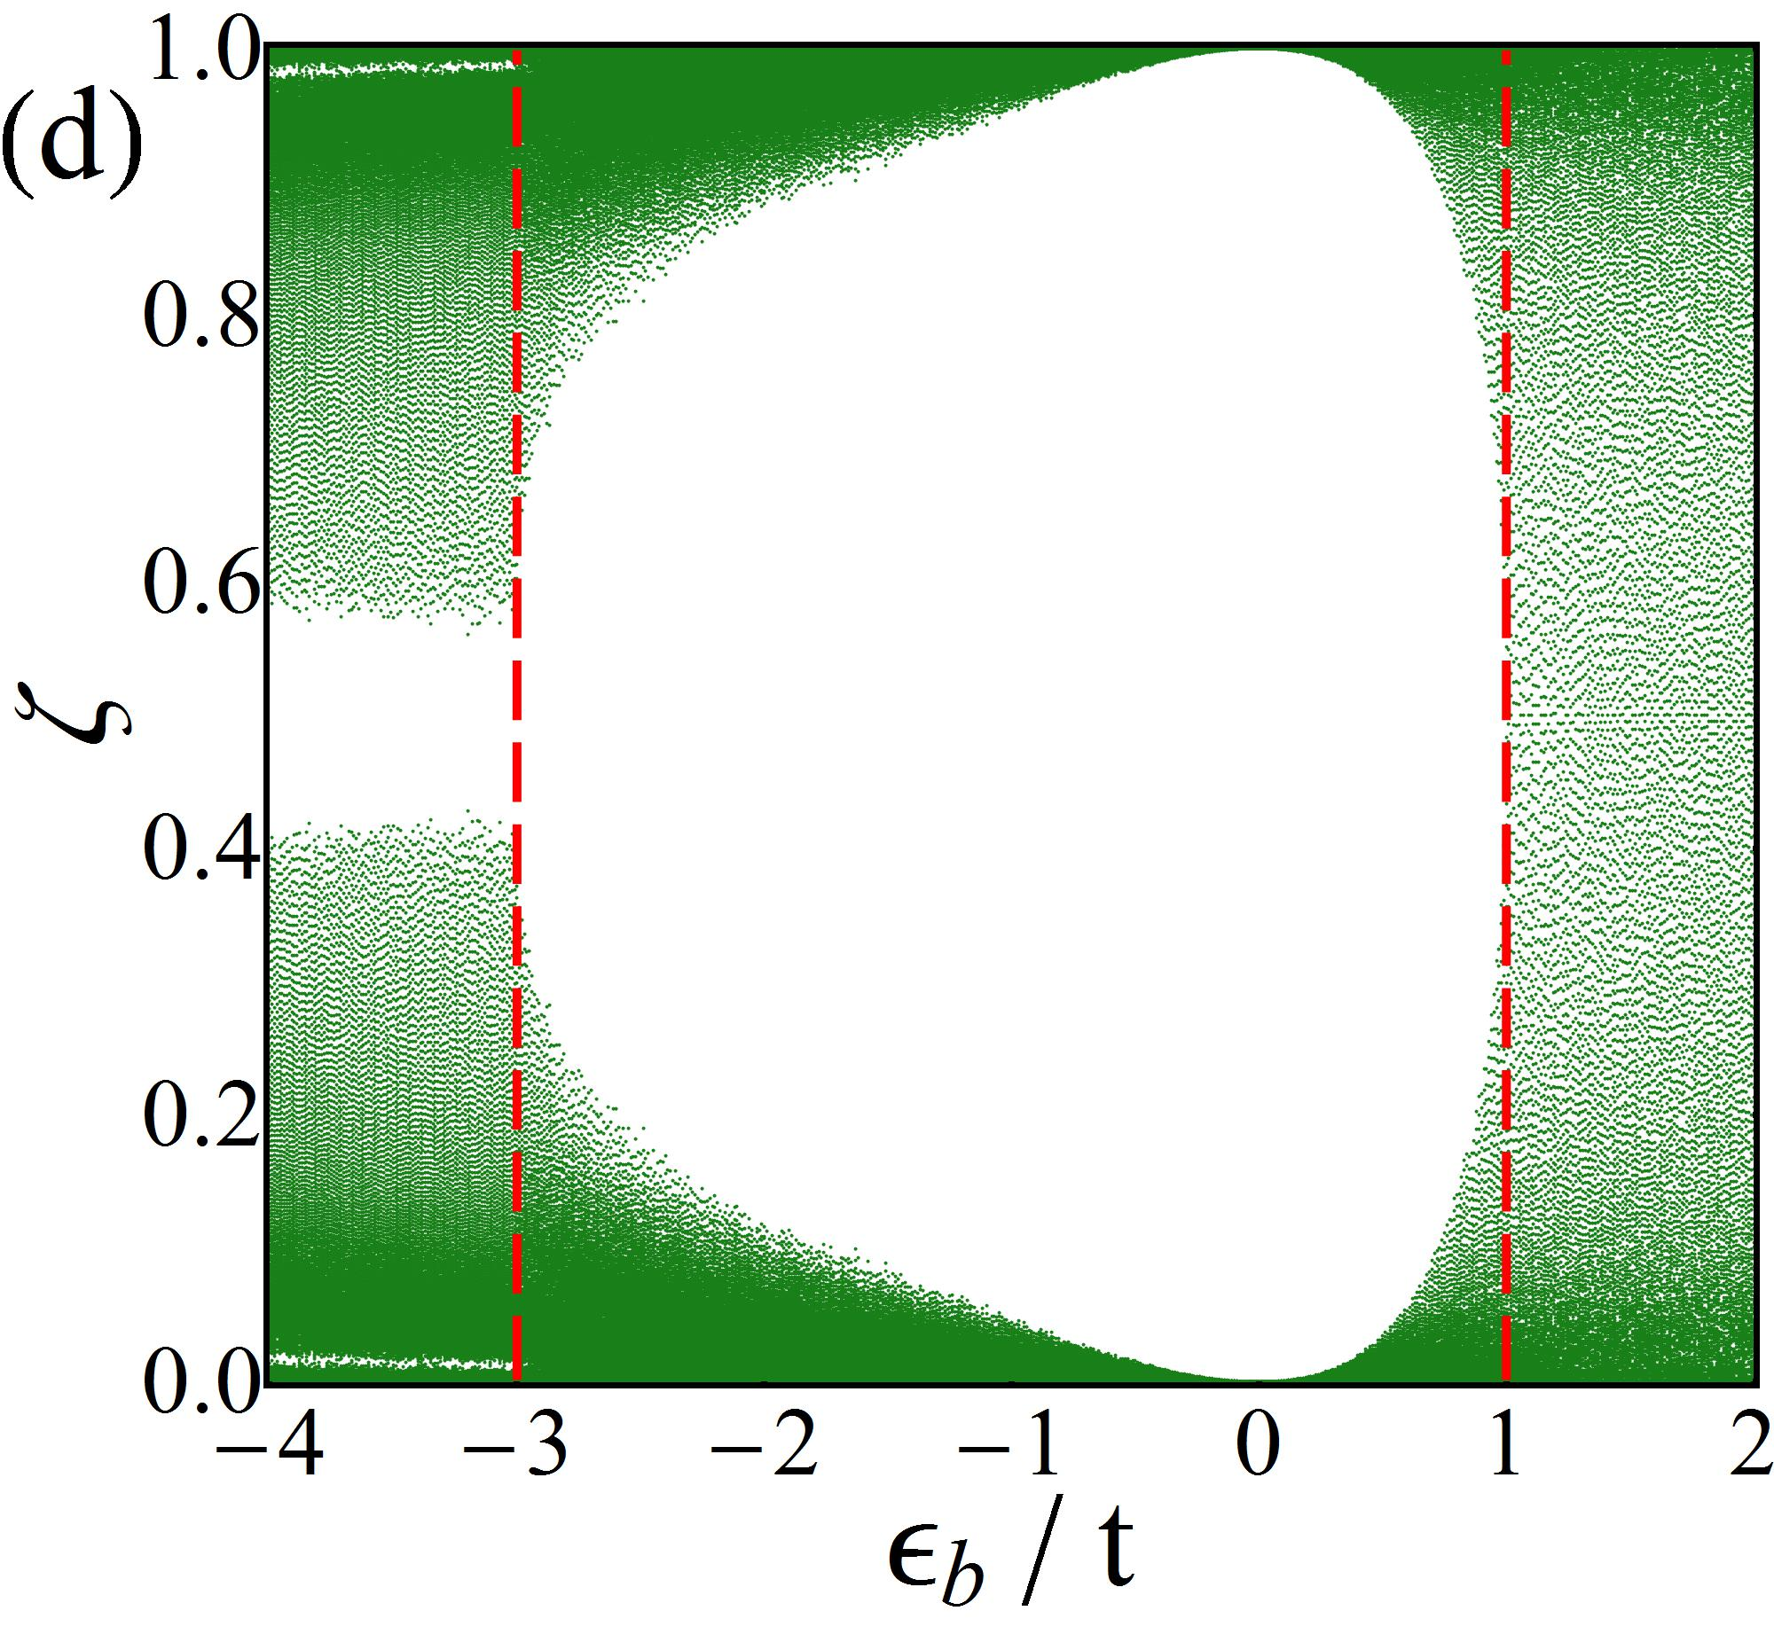
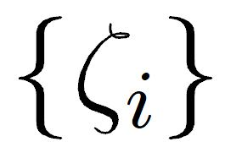
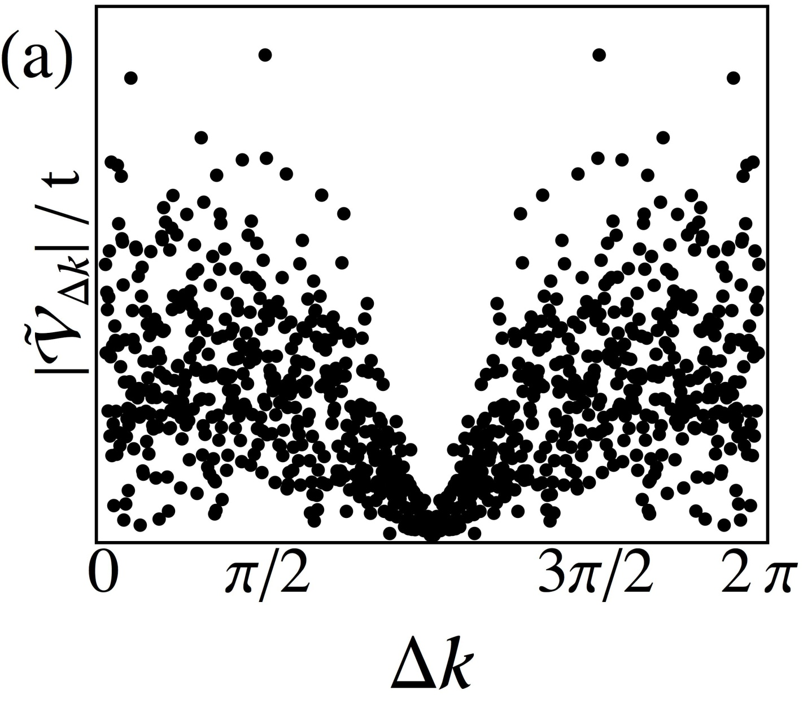
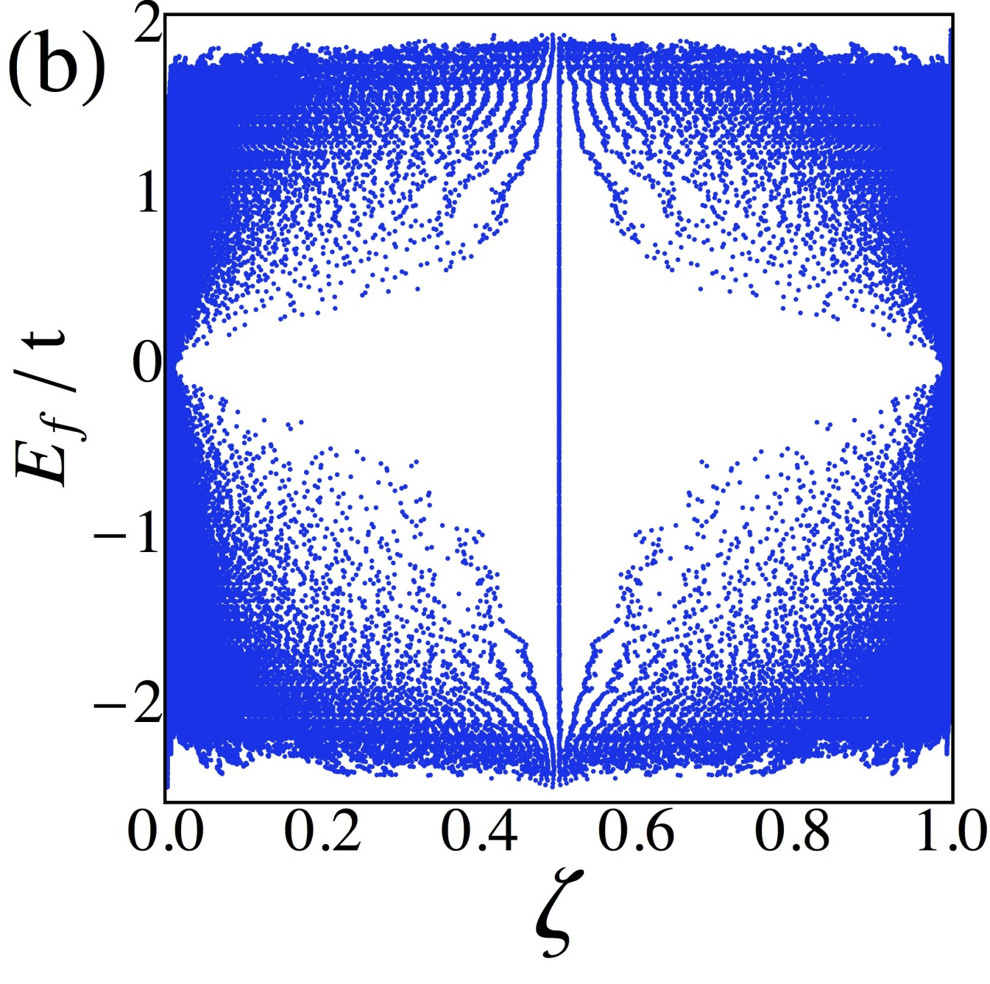
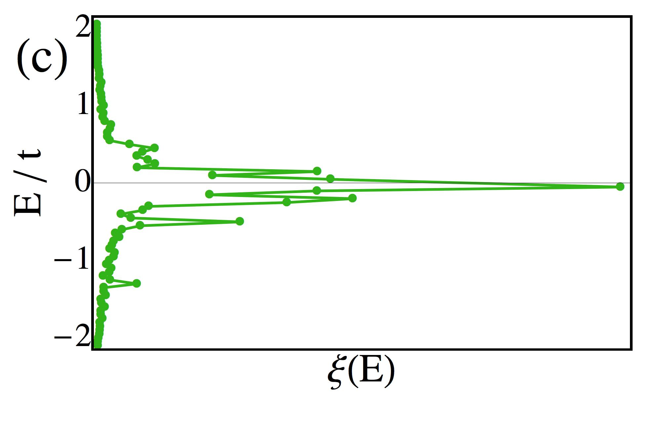
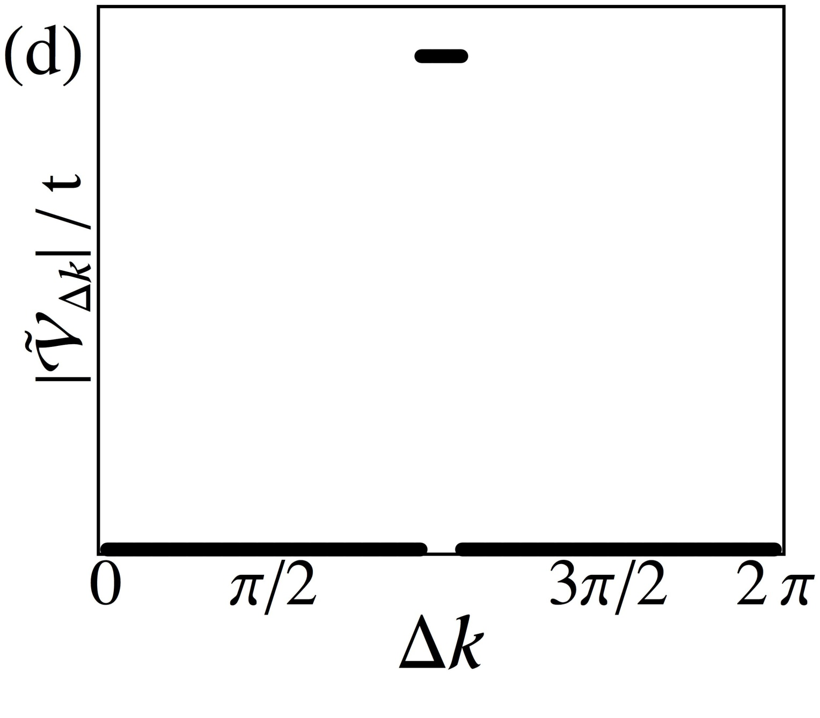
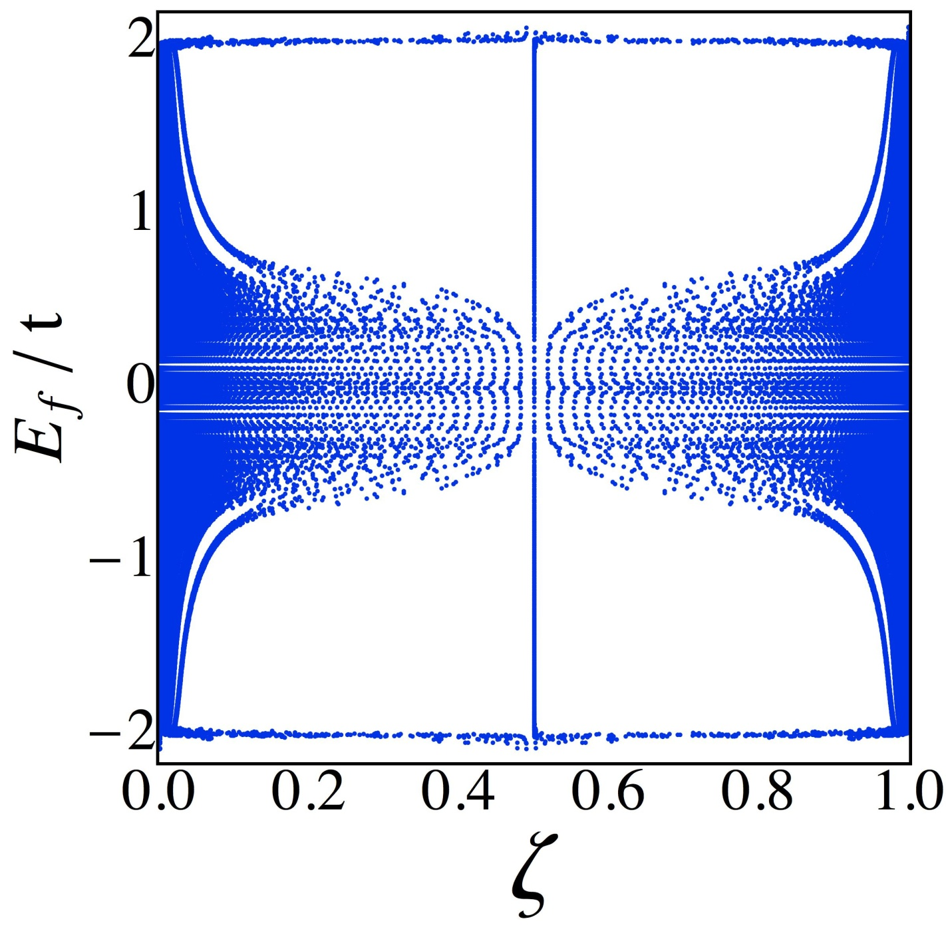
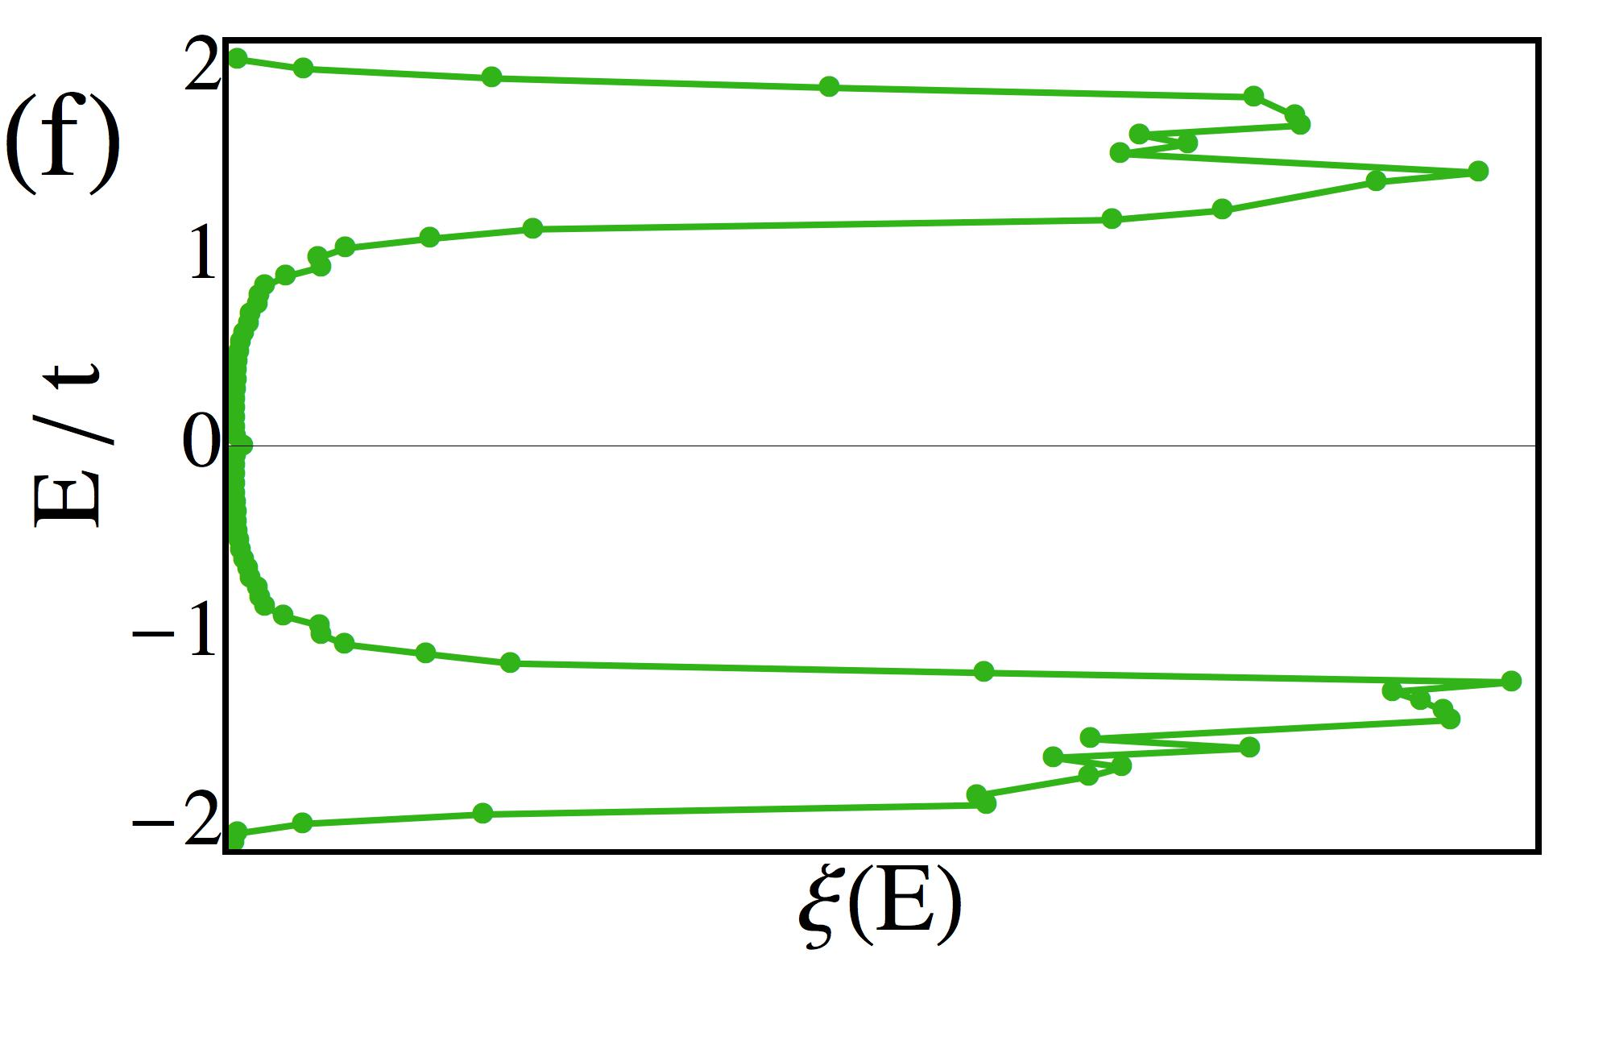
Momentum entanglement of 1D disordered fermions
Ian Mondragon-Shem, Mayukh Khan and Taylor Hughes
Department of Physics, University of Illinois, Urbana-Champaign
Introduction
Spatial entanglement presents some vague signatures:
Momentum entanglement reveals the key properties sharply:
Objective
To reveal extended states and metal-insulator transitions in 1D disordered systems using momentum entanglement
Evidence of extended states
Example model for study
Lattice models with correlated disorder [1]:
Random dimers
Random trimers
Key properties of these models:
Finite fraction of extended states at resonant energies
Extended states disappear at strong enough disorder
Evidence of metal-insulator transition
Entanglement measure
A
B
So, does this happen in other systems?
The important underlying feature:
Conclusion
Models which suppress left-right-mover scattering leads to momentum entanglement suppression, and helps to reveal extended states and metal-insulator transitions in one dimension.
References
[1] D. H. Dunlap, H.-L.Wu, and P. W. Phillips, Phys. Rev. Lett. 65, 88 (1990)
[2] I. Peschel, Journal of Physics A Mathematical General 36, L205 (Apr. 2003)

